Slide 1


Shahrul
25WW5

Slide 2

Outline
Executive Summary
Introduction
Methodology
Results
Conclusion
Appendix

Slide 3
Executive Summary
Summary of methodologies
Data Collection: Collected data from an API to predict Falcon 9's first-stage landing success.
Data Preprocessing: Cleaned and formatted the dataset for analysis.
Modeling: Applied classification algorithms such as Decision Trees, K-Nearest Neighbors, and Support Vector Machines (SVM) for prediction.
Hyperparameter Tuning: Used GridSearchCV for model optimization and cross-validation to find the best parameters.
Evaluation: Assessed model accuracy using test data and determined the best-performing model.
Summary of all results
Best Model: Support Vector Machine (SVM) with the RBF kernel showed the highest accuracy on the validation dataset.
Model Accuracy: The SVM model achieved a high accuracy rate in predicting landing success.
Model Insights: The prediction model can be used for estimating launch costs and improving competitive bidding strategies.

Slide 4
Introduction
Project background and context
This project predicts the success of the Falcon 9 first stage landing. SpaceX’s ability to reuse the first stage reduces launch costs from $165 million to $62 million, making it a major cost-saving factor. Predicting landing success can help estimate launch costs and provide competitive insights for other companies.
Problems you want to find answers
Will the Falcon 9 first stage land successfully?
How does landing success impact launch cost?
How can this prediction help other companies compete with SpaceX?

Slide 5

Section 1

Slide 6
Methodology
Executive Summary
Data collection methodology:
Describe how data was collected
Perform data wrangling
Describe how data was processed
Perform exploratory data analysis (EDA) using visualization and SQL
Perform interactive visual analytics using Folium and Plotly Dash
Perform predictive analysis using classification models
How to build, tune, evaluate classification models

Slide 7
Data Collection
API Integration: Data was collected from a publicly available API providing information on Falcon 9 rocket launches.
Data Access: Utilized a Python library (like requests or urllib) to send GET requests to the API.
Data Retrieval: API responses were in JSON format, containing launch details such as mission IDs, date, and landing success.
Data Formatting: Cleaned the raw data by handling missing values, normalizing features, and encoding categorical variables.
Feature Extraction: Key variables like launch date, rocket type, and weather conditions were extracted for analysis.
Data Storage: The data was stored in a structured format (e.g., pandas DataFrame) for easy manipulation and model training.

Slide 8
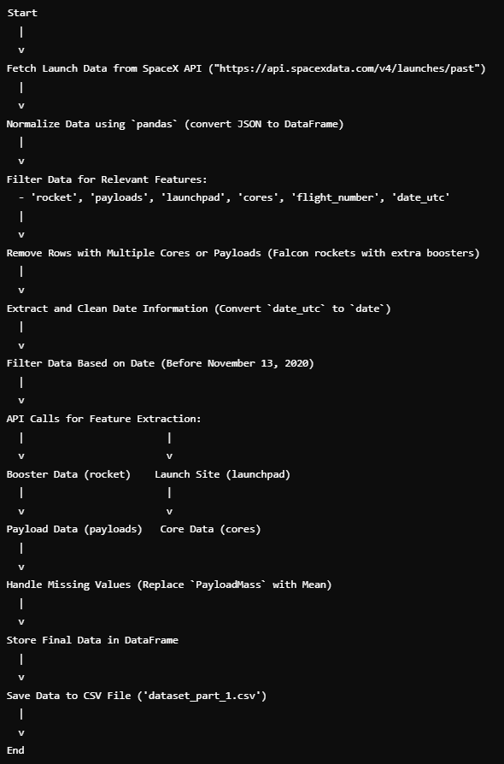
Data Collection – SpaceX API
Present your data collection with SpaceX REST calls using key phrases and flowcharts
https://github.com/nizamfadzillah/testrepo/blob/main/Module1/jupyter-labs-spacex-data-collection-api-v2.ipynb

Slide 9
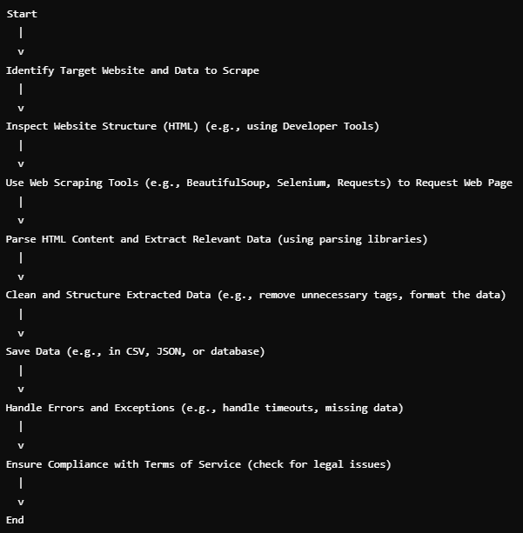
Data Collection - Scraping
Present your web scraping process using key phrases and flowcharts
https://github.com/nizamfadzillah/testrepo/blob/main/Module1/jupyter-labs-webscraping.ipynb

Slide 10
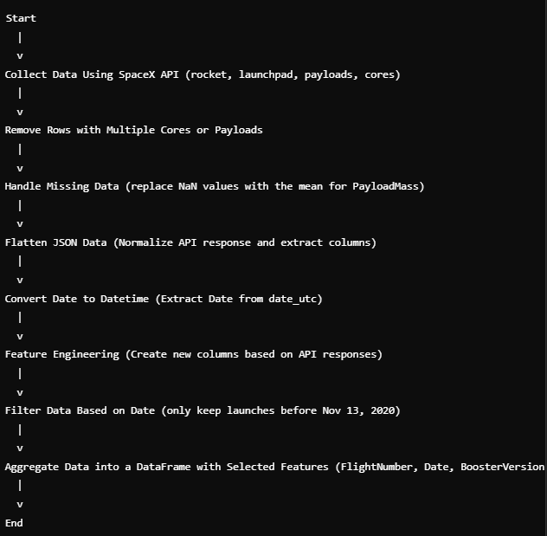
Data Wrangling
Describe how data were processed
You need to present your data wrangling process using key phrases and flowcharts
https://github.com/nizamfadzillah/testrepo/blob/main/Module1/labs-jupyter-spacex-Data%20wrangling-v2.ipynb

Slide 11
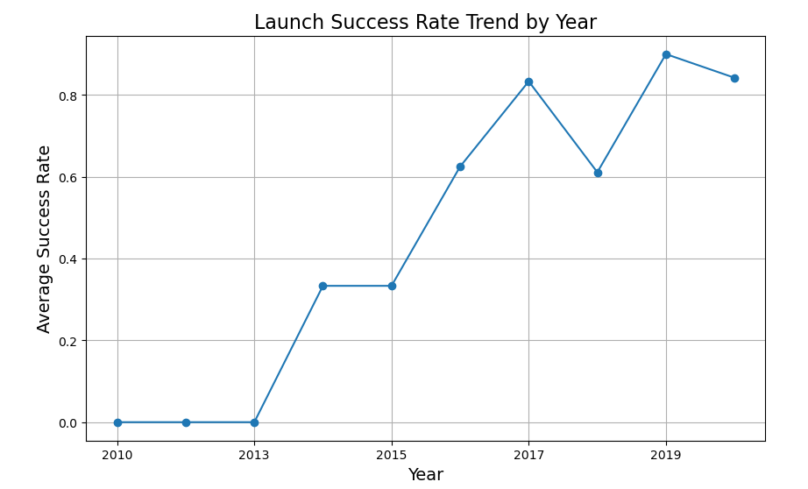
EDA with Data Visualization
Summarize Launch Success Rate Trend increase by year
https://github.com/nizamfadzillah/testrepo/blob/main/Module2/jupyter-labs-eda-dataviz-v2.ipynb

Slide 12
EDA with SQL
Using bullet point format, summarize the SQL queries you performed
Task 1: Retrieved unique launch sites from the dataset.
Task 2: Displayed 5 records with launch sites starting with 'CCA’.
Task 3: Summed the total payload mass for NASA (CRS) missions.
Task 4: Calculated the average payload mass for F9 v1.1 boosters.
Task 5: Found the date of the first successful ground pad landing.
Task 6: Listed boosters with successful drone ship landings and payload mass between 4000 and 6000 kg.
Task 7: Counted the total number of successful and failed missions.
Task 8: Identified boosters that carried the maximum payload mass.
Task 9: Listed records with failure outcomes on drone ships for the year 2015, including month names.
Task 10: Ranked landing outcomes between 2010-06-04 and 2017-03-20 by count, in descending order
https://github.com/nizamfadzillah/testrepo/blob/main/Module2/jupyter-labs-eda-sql-coursera_sqllite.ipynb

Slide 13
Build an Interactive Map with Folium
Summarize what map objects such as markers, circles, lines, etc. you created and added to a folium map
Marker(s): These were added to specific locations on the map, marked by latitude and longitude coordinates. Markers were chosen to represent specific points of interest, such as locations tied to the data or relevant features.
Circle(s): Circles were added to highlight areas around specific markers, providing a visual representation of a certain radius or impact area. This helps to emphasize certain regions or focus on a particular area.
Polyline/Line(s): Lines or polylines were added to show connections or paths between points. These help visualize relationships between different locations or the flow of movement, whether spatial or directional.
Popup(s): Popups were associated with markers, offering additional context or detailed information about the location when clicked. This helps to provide more information interactively.
Choropleth (if applicable): This might have been used to color regions based on a variable, allowing the user to quickly assess spatial patterns.These objects were added to improve the visualization by making key data points more accessible, interactive, and visually engaging. By adding markers, circles, lines, and popups, I enhanced the map's ability to communicate relevant data effectively.
https://github.com/nizamfadzillah/testrepo/blob/main/Module3/lab-jupyter-launch-site-location-v2.ipynb

Slide 14
Build a Dashboard with Plotly Dash
Summarize what plots/graphs and interactions you have added to a dashboard
Interactivity: The dropdown, slider, and callbacks make the dashboard interactive, allowing users to filter and explore different aspects of the dataset dynamically. Users can focus on specific launch sites, payload ranges, or analyze success/failure by different parameters.
Data Exploration: The pie chart and scatter plot provide visual insights into key aspects of SpaceX launches—success rates by site, success versus payload size, and the influence of booster versions on launch success. This allows users to easily interpret complex relationships within the data.
User Engagement: The combination of interactivity and insightful visualizations enhances user engagement, allowing for a more customized and detailed exploration of the SpaceX launch data.
https://github.com/nizamfadzillah/testrepo/blob/main/Module3/Build%20an%20Interactive%20Dashboard%20with%20Ploty%20Dash.py

Slide 15
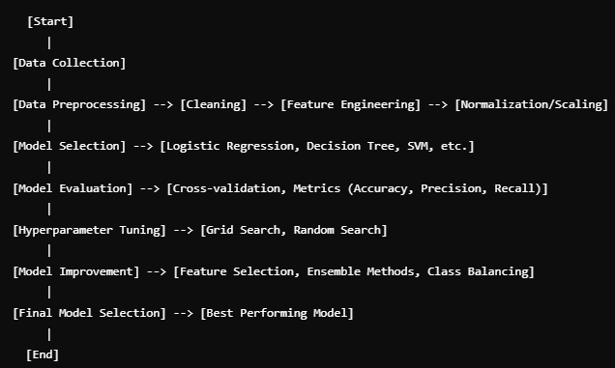
Predictive Analysis (Classification)
Summarize how you built, evaluated, improved, and found the best performing classification model
https://github.com/nizamfadzillah/testrepo/blob/main/Module4/SpaceX-Machine-Learning-Prediction-Part-5-v1.ipynb

Slide 16
Results
Exploratory data analysis results
Interactive analytics demo in screenshots
Predictive analysis results

Slide 17

Section 2

Slide 18
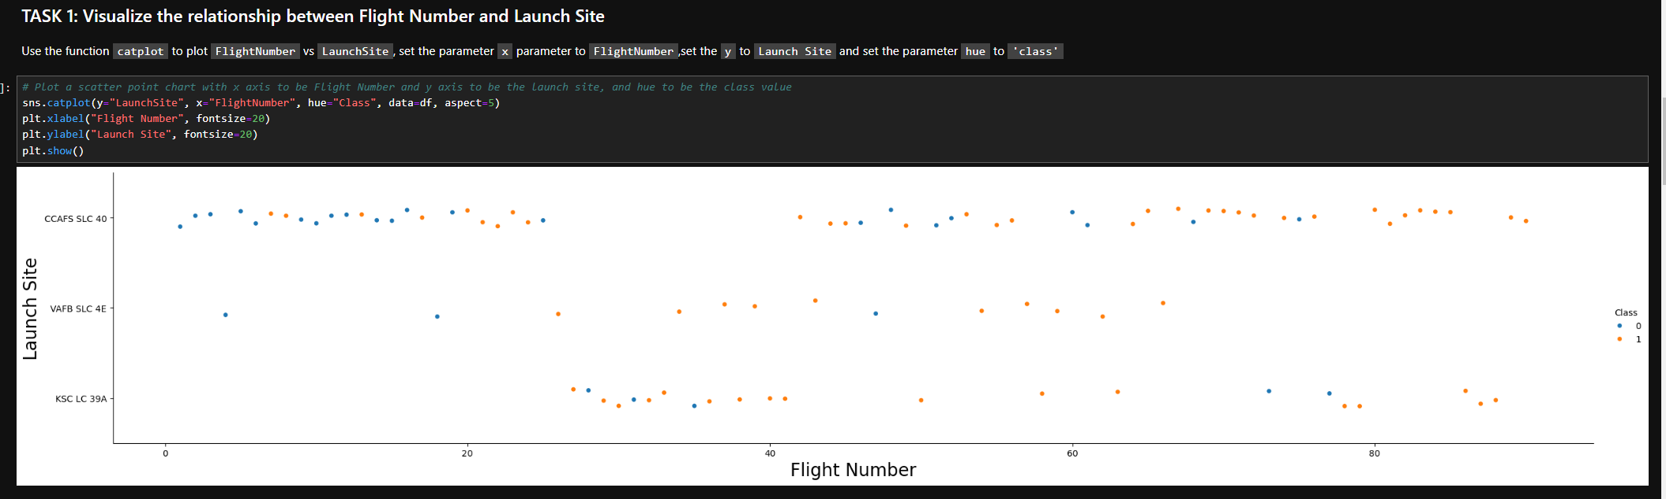
Flight Number vs. Launch Site
Show a scatter plot of Flight Number vs. Launch Site
Show the screenshot of the scatter plot with explanations

Slide 19
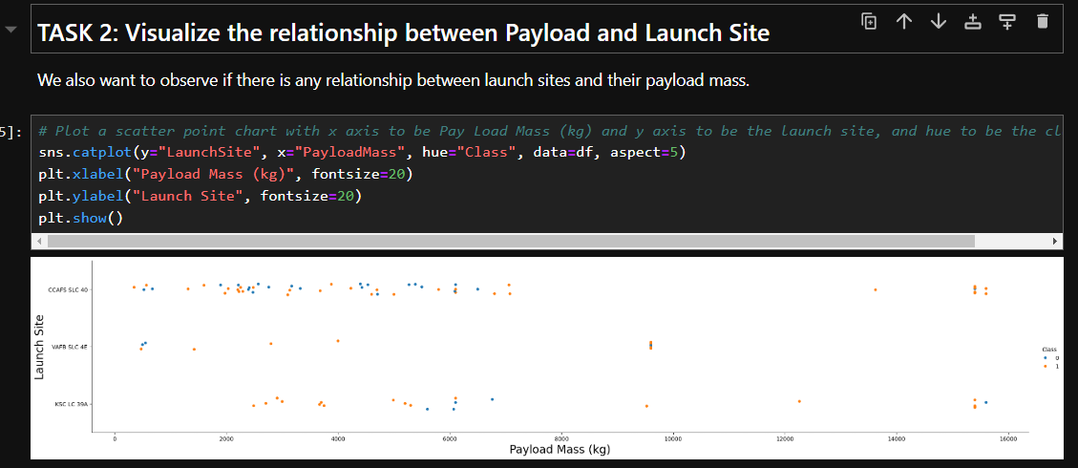
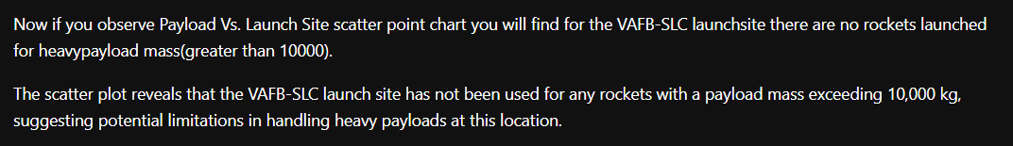
Payload vs. Launch Site
Show a scatter plot of Payload vs. Launch Site
Show the screenshot of the scatter plot with explanations

Slide 20
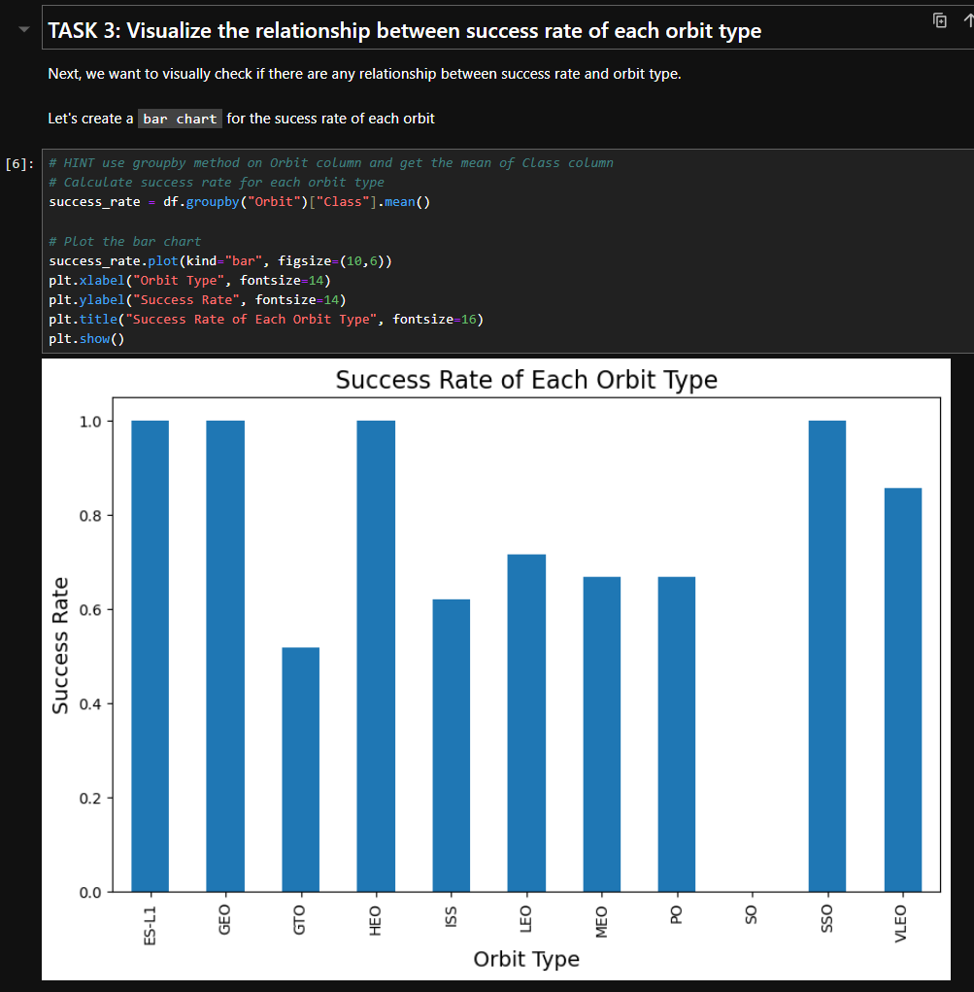
Success Rate vs. Orbit Type
Show a bar chart for the success rate of each orbit type
Show the screenshot of the scatter plot with explanations

Slide 21
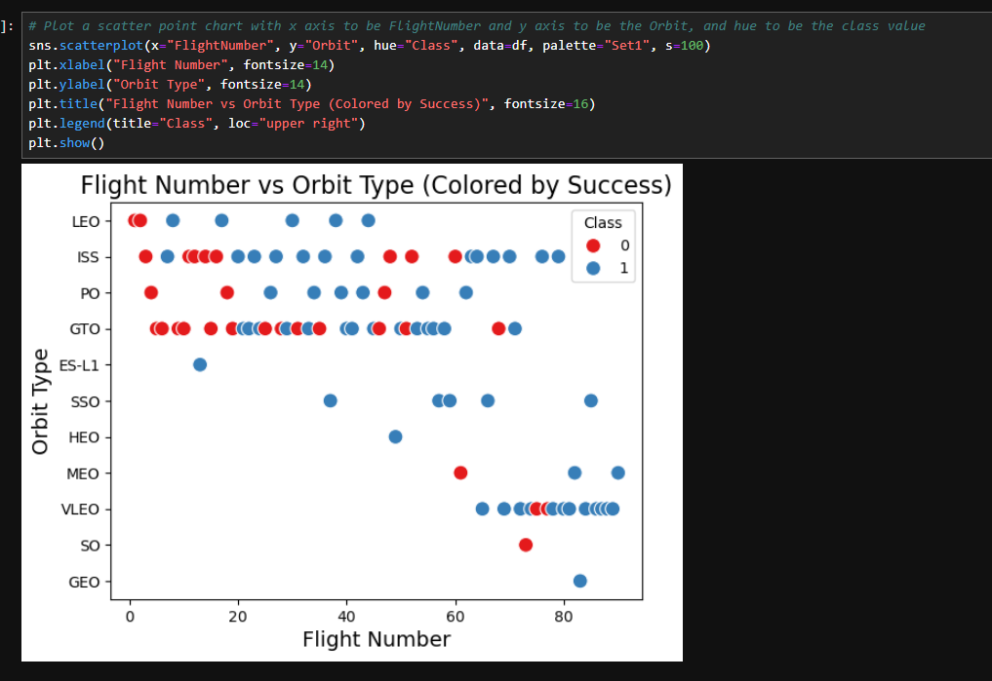
Flight Number vs. Orbit Type
Show a scatter point of Flight number vs. Orbit type
Show the screenshot of the scatter plot with explanations

Slide 22
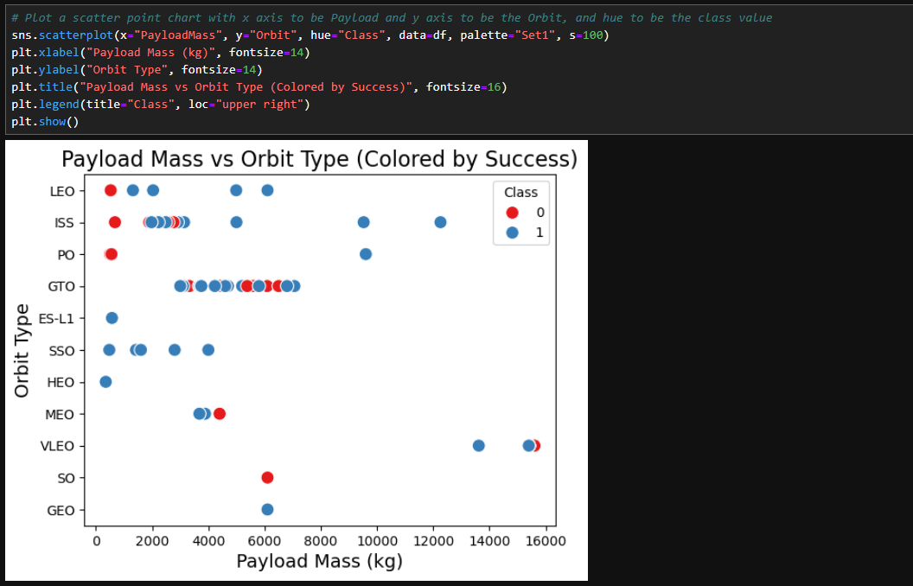
Payload vs. Orbit Type
Show a scatter point of payload vs. orbit type
Show the screenshot of the scatter plot with explanations

Slide 23
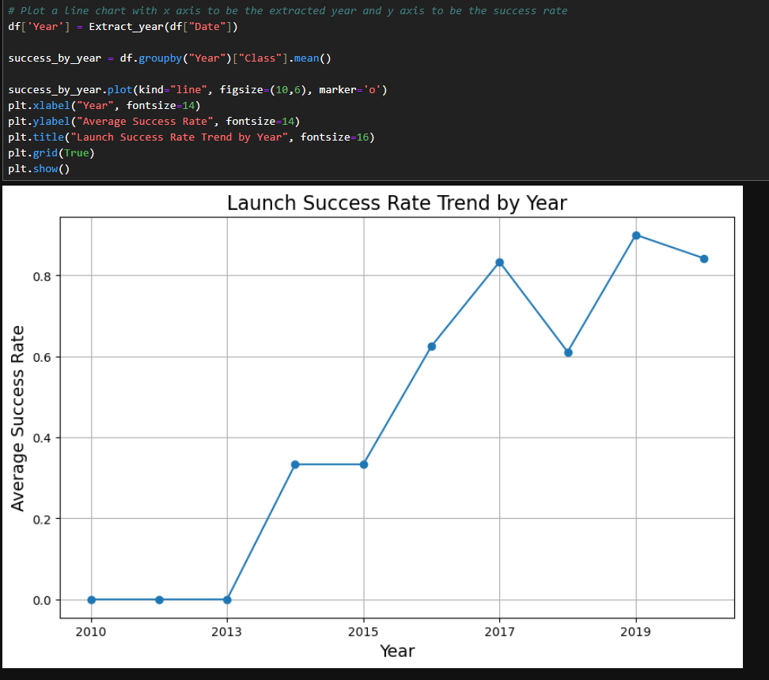
Launch Success Yearly Trend
Show a line chart of yearly average success rate
Show the screenshot of the scatter plot with explanations

Slide 24
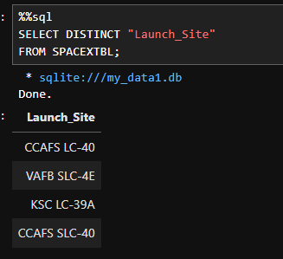
All Launch Site Names
Find the names of the unique launch sites
Present your query result with a short explanation here

Slide 25
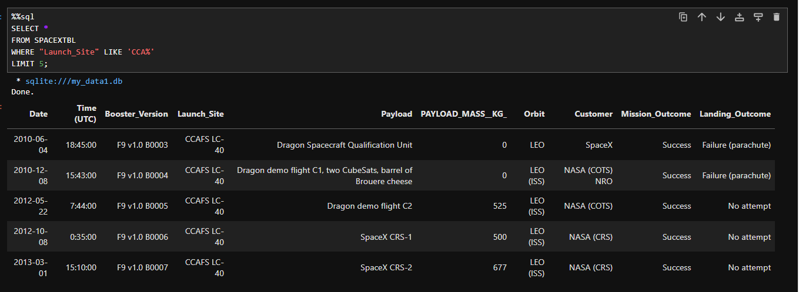
Launch Site Names Begin with 'CCA'
Find 5 records where launch sites begin with `CCA`
Present your query result with a short explanation here

Slide 26
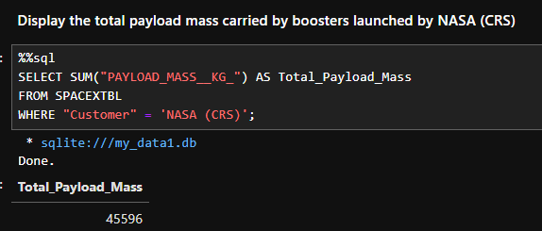
Total Payload Mass
Calculate the total payload carried by boosters from NASA
Present your query result with a short explanation here

Slide 27
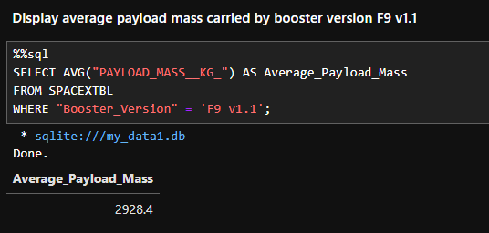
Average Payload Mass by F9 v1.1
Calculate the average payload mass carried by booster version F9 v1.1
Present your query result with a short explanation here

Slide 28
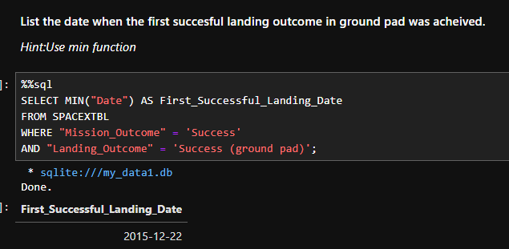
First Successful Ground Landing Date
Find the dates of the first successful landing outcome on ground pad
Present your query result with a short explanation here

Slide 29
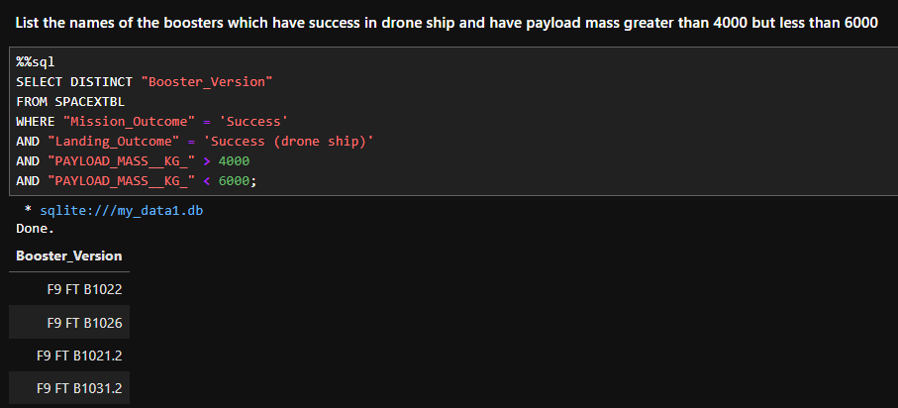
Successful Drone Ship Landing with Payload between 4000 and 6000
List the names of boosters which have successfully landed on drone ship and had payload mass greater than 4000 but less than 6000
Present your query result with a short explanation here

Slide 30
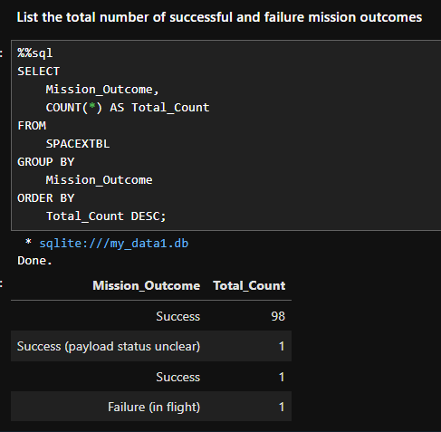
Total Number of Successful and Failure Mission Outcomes
Calculate the total number of successful and failure mission outcomes
Present your query result with a short explanation here

Slide 31
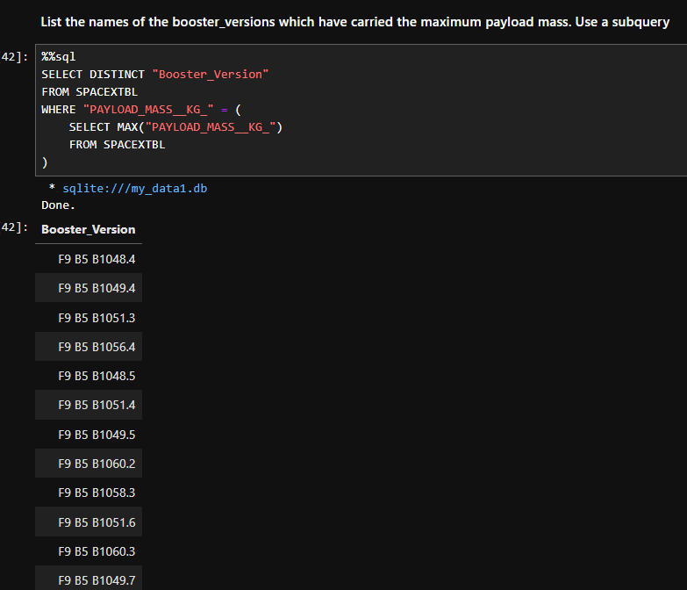
Boosters Carried Maximum Payload
List the names of the booster which have carried the maximum payload mass
Present your query result with a short explanation here

Slide 32
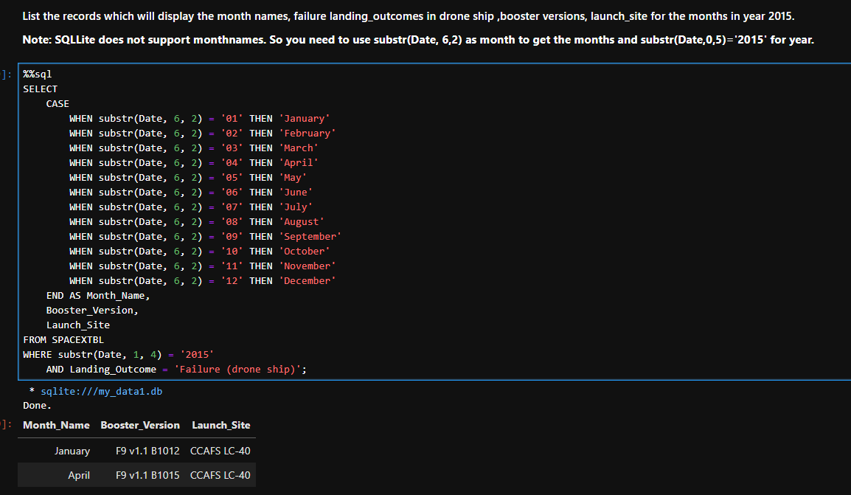
2015 Launch Records
List the failed landing_outcomes in drone ship, their booster versions, and launch site names for in year 2015
Present your query result with a short explanation here

Slide 33
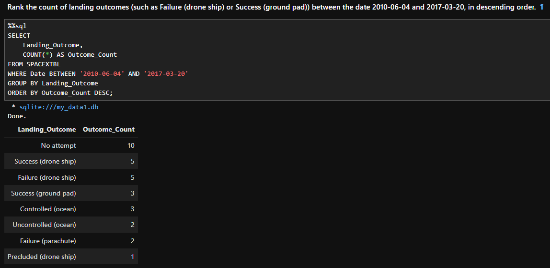
Rank Landing Outcomes Between 2010-06-04 and 2017-03-20
Rank the count of landing outcomes (such as Failure (drone ship) or Success (ground pad)) between the date 2010-06-04 and 2017-03-20, in descending order
Present your query result with a short explanation here

Slide 34

Section 3

Slide 35
<Folium Map Screenshot 1>
Replace <Folium map screenshot 1> title with an appropriate title
Explore the generated folium map and make a proper screenshot to include all launch sites’ location markers on a global map
Explain the important elements and findings on the screenshot

Slide 36
<Folium Map Screenshot 2>
Replace <Folium map screenshot 2> title with an appropriate title
Explore the folium map and make a proper screenshot to show the color-labeled launch outcomes on the map
Explain the important elements and findings on the screenshot

Slide 37
<Folium Map Screenshot 3>
Replace <Folium map screenshot 3> title with an appropriate title
Explore the generated folium map and show the screenshot of a selected launch site to its proximities such as railway, highway, coastline, with distance calculated and displayed
Explain the important elements and findings on the screenshot

Slide 38

Section 4

Slide 39
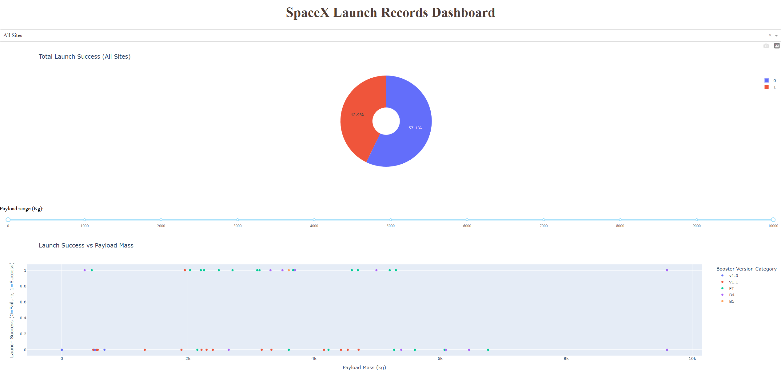
<Dashboard Screenshot 1>
Replace <Dashboard screenshot 1> title with an appropriate title
Show the screenshot of launch success count for all sites, in a piechart
Explain the important elements and findings on the screenshot

Slide 40
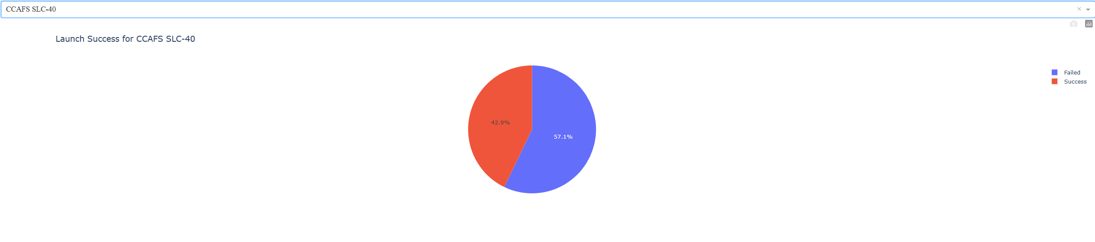
<Dashboard Screenshot 2>
Replace <Dashboard screenshot 2> title with an appropriate title
Show the screenshot of the piechart for the launch site with highest launch success ratio
Explain the important elements and findings on the screenshot

Slide 41
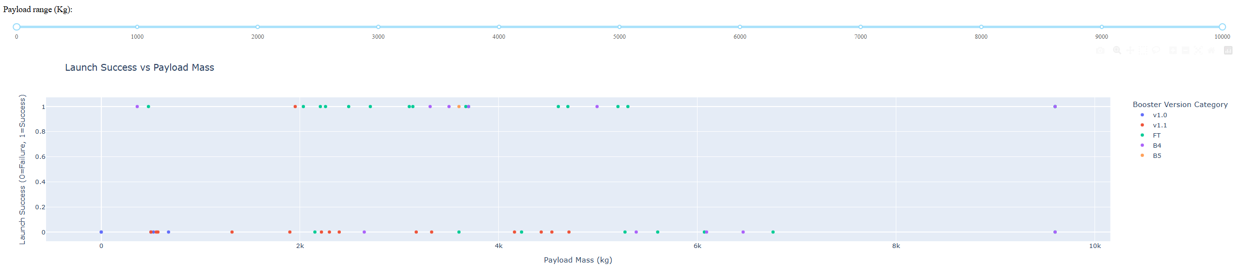
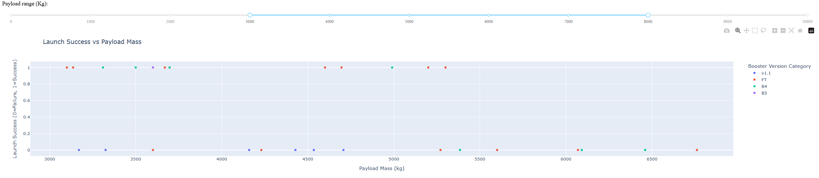
<Dashboard Screenshot 3>
Replace <Dashboard screenshot 3> title with an appropriate title
Show screenshots of Payload vs. Launch Outcome scatter plot for all sites, with different payload selected in the range slider
Explain the important elements and findings on the screenshot, such as which payload range or booster version have the largest success rate, etc.

Slide 42

Section 5

Slide 43
Classification Accuracy
All model have same accuracy

Slide 44
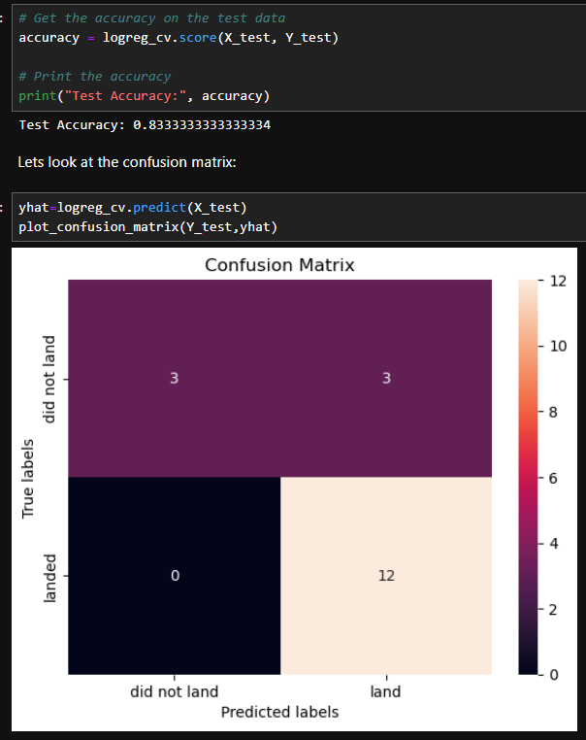
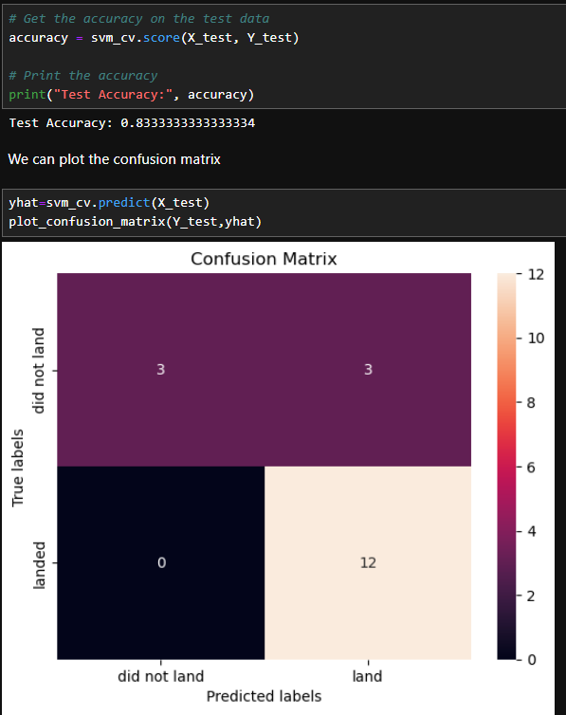
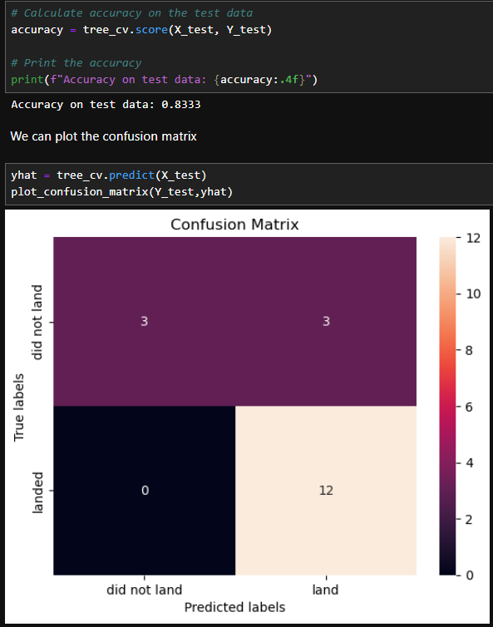
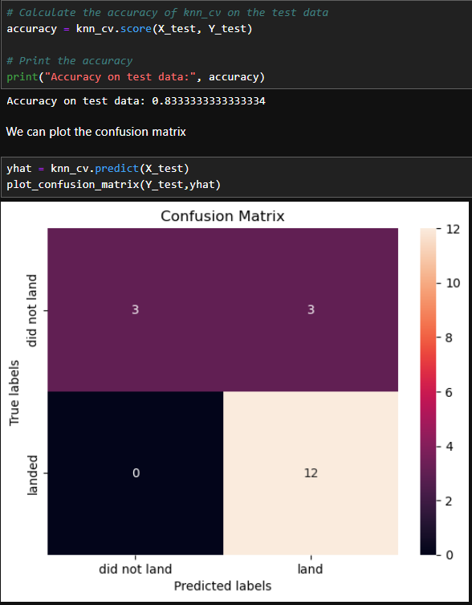
Confusion Matrix
Show the confusion matrix of the best performing model with an explanation

Slide 45
Conclusions
Point 1
Point 2
Point 3
Point 4
…

Slide 46
Appendix
Include any relevant assets like Python code snippets, SQL queries, charts, Notebook outputs, or data sets that you may have created during this project

Slide 47


